Slide 1

INX – Moodle

Slide 2


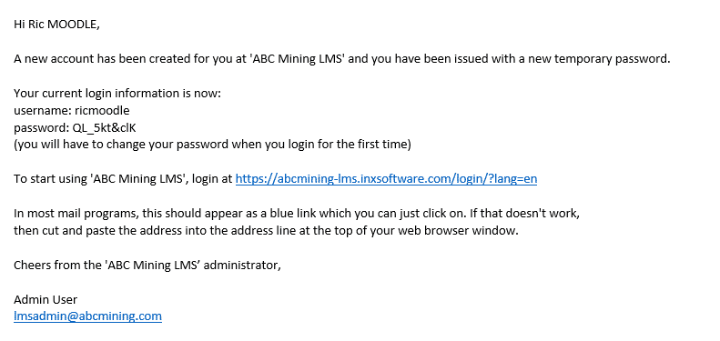
Log In
All personnel across site and head office will Receive a system-generated email from INX containing login instructions and a link to access your personal training dashboard. Please see the example email below for reference.
Please check your Spam folder if you do not receive it.
Please keep this email handy if you lose your log in details, please contact inxsupport@aimmining.com.au

Slide 3

Log In
Click on the link
https://calidus-moodle.inxsoftware.com/login/index.php
And it will bring you to the log in page
Enter your username and password that your received on your email
Click the Log in Button.
Raising an Incident Report

Slide 4

Home page
Once you have logged in it will bring you to the home page

Slide 5

My Courses
At the top of the screen, you will see My courses
Click on this
Th is will bring you to the Landing page with all your online course, inductions and procedures that you need to complete as part of your role at AIM

Slide 6
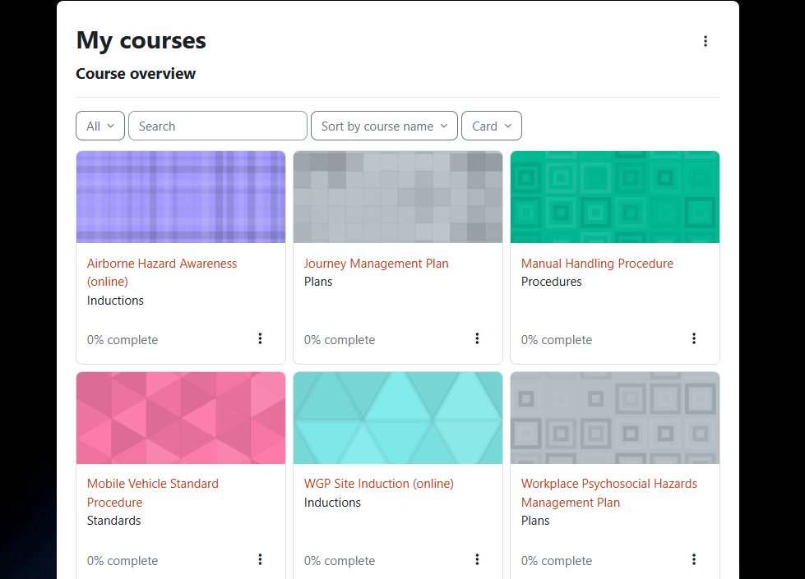
My Course
You are now on the landing page for all your outstanding on-line courses, inductions and procedures

Slide 7
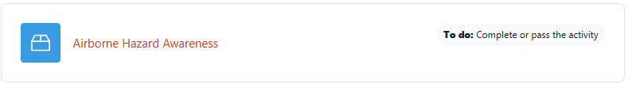
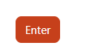

My Courses
Click on the course or induction you wish to complete
It will bring you to this screen, click on the course or induction
Then click enter
You will then be taken to the course or induction

Slide 8
My Course
Once completed you will be taken back to the landing page and the course or induction will have disappeared.
Your profile in Intution will update automatically that you have completed this course

Slide 9
My Course – Procedure
You are now on the landing page for all your outstanding procedures

Slide 10
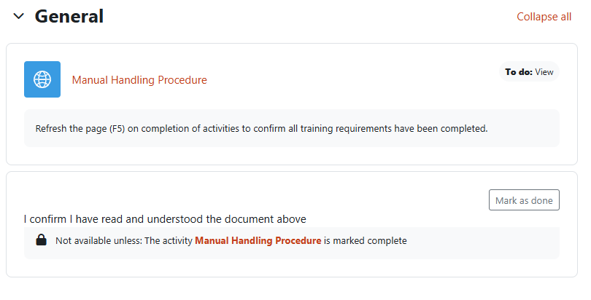
My Courses - Procedures
Click on the Procedure you wish to complete

Slide 11
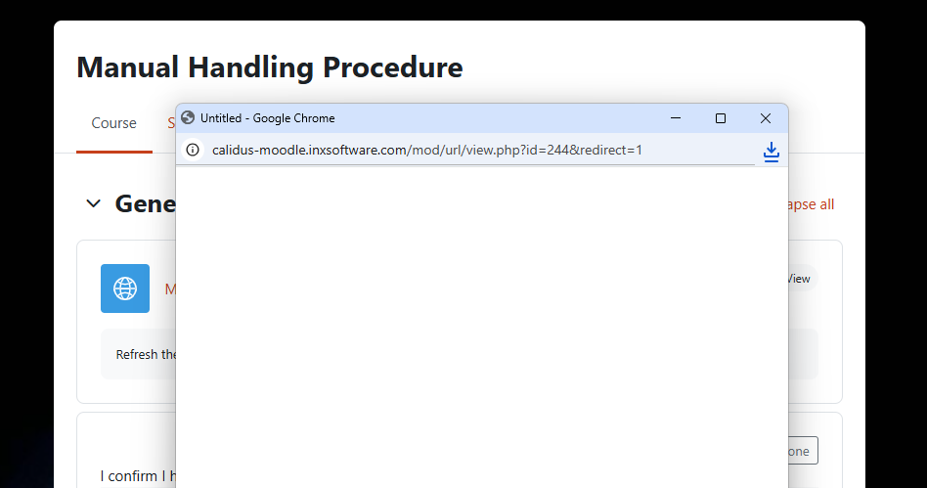
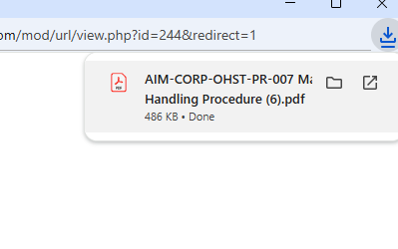
My Courses - Procedures
A pop up screen will appear. Click on the PDF in the download icon

Slide 12
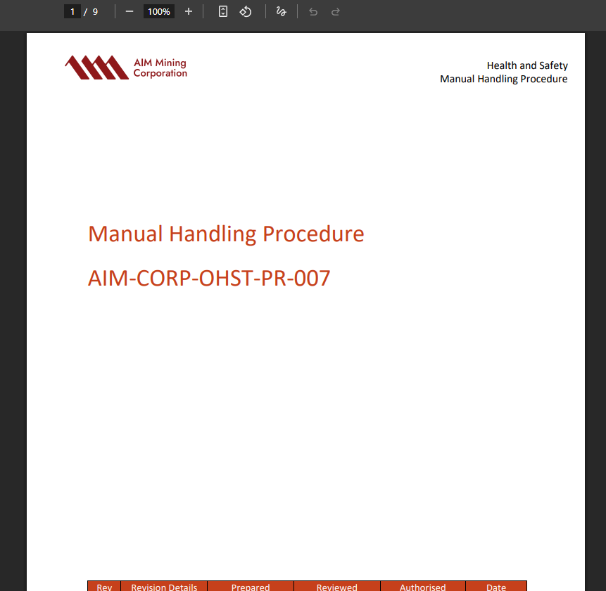
My Courses - Procedures
Once the document has opened – read the procedure

Slide 13

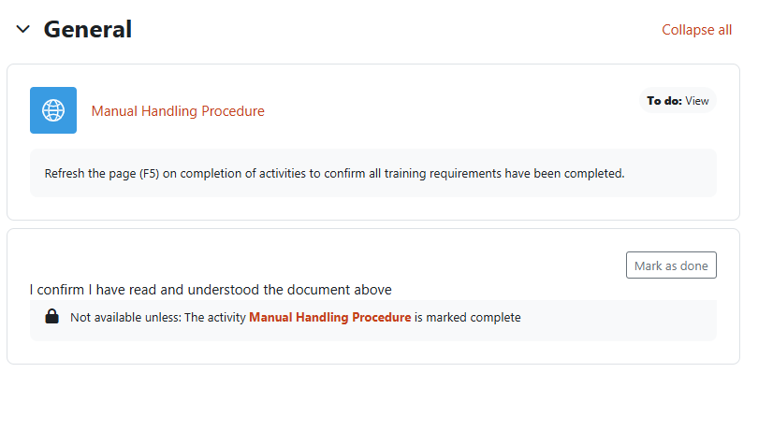
My Courses - Procedures
Once You have read the procedure you can close out and go back to the Moodle procedure screen.
Click on the Mark as done – to confirm you have read and understood the document.

Slide 14
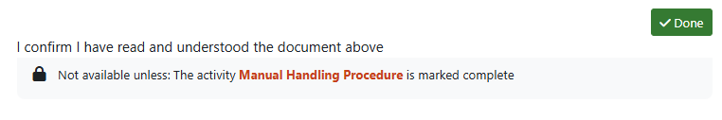

My Course
Once you have Marked as done .
Click on the My course tab at the top of the screen.
This will take you back to the Landing page
Your profile in Intution will update automatically that you have completed this Procedure

Slide 15
TROUBLE SHOOTING
POP-UP BLOCKERS PREVENTING THE COURSE FROM OPENING
All of our online training courses use pop-ups making it easier to view a course in a new window; however some browsers may block pop-ups from opening.
If the message below appears, you will need to enable popups – it will appear on the address bar as shown directly below:
Click on this button on your address Bar
Google Chrome and Microsoft Edge
• Click on the message or icon.
• Select always allow pop-ups and redirects.
• Select done.

Slide 16
TROUBLE SHOOTING
FireFox
A message will appear saying Firefox prevented this site from opening a pop-up window under the address bar:
Click on the options button.
Select allow pop-ups.
Safari
Select Safari > Preferences
Click on Security at the top of the window.
Under web content:
Check the Block pop-up windows option to enable this feature.
Uncheck the option it to disable it.

Slide 17
TROUBLE SHOOTING
WHO TO CONTACT IF YOU HAVE ONGOING, OR FURTHER ISSUES
If you have any questions or issues that haven’t been able to be resolved:
For new starters, contact the mobilisation team in the first instance.
Email your query to inxsupport@aimmining.com.au for assistance.

